Slide 1

DATA-DRIVEN DECISIONS: UNLOCKING BUSINESS INSIGHTS THROUGH DASHBOARD ANALYTICS
TEAM NAME: 0704 DVA TEAM 34

Slide 2


OUR TEAM MEMBERS
Sri Hari Ganesh Reddy Konala
Abeer Asif
V N HARINI
Vivek puspalak
Syed Nazmul Hasan
Dinesh Ruthala

Slide 3

PROJECT OBJECTIVE
To build an interactive, validated dashboard using PostgreSQL and analytical tools that:
Identifies key trends in enrollment and campaign data.
Highlights geographic and performance insights.
Enables data-driven decision-making.

Slide 4
PROJECT INSIGHTS
KEY PROCESSES:
Data cleaning & standardization​
Exploratory Data Analysis (EDA)​
Data validation & integration using PostgreSQL
OUTCOMES
Detect trends and data quality issues
Create a dynamic dashboard visualizing:
▫ Enrollment & participation trends
▫ Advertising campaign performance
▫ Geographic distribution

Slide 5
OVERVIEW OF THE DATASETS

Slide 6
USER DATA OVERVIEW
Description: User profile details, including demographics, education background, and sign-up timestamps
Source: CRM / Application Forms
Timeframe: Captured as a static snapshot, though updated regularly.
Records & Variables: 129.259K records; Learner_id, Country, Degree, Institution, Major

Slide 7
OPPORTUNITY DATA OVERVIEW
Description: Learning opportunities, including program details, cohort associations, sponsorships, and user participation metrics
Source: An educational or career platform
Timeframe: Unknown, likely periodic (e.g., semester-based) due to terms like 'Early Internship' and event-like names
Records & Variables: 187 records; opportunity_id, opportunity_code, category, opportunity_name, tracking_questions

Slide 8
COHORT DATA OVERVIEW
Description: Cohort-based learning programs, including cohort sizes, timelines, and linked opportunities
Source: Educational or training program cohorts
Timeframe: Captured as a static snapshot, though updated regularly.
Records & Variables: 639 records; Cohort_id, Cohort_code, Start_date, End_date, size

Slide 9
LEARNER OPPORTUNITY DATA OVERVIEW
Description: Contains mappings between learners and learning opportunities, including cohort assignments and application status.
Source: likely exported from the CRM (CUSTOMER RELATIONSHIP MANAGEMENT) or LMS (LEARNING MANAGEMENT SYSTEM) platform
Records: 113,602
Variables:enrollment_id,learner_id,assigned_cohort,apply_data ,status

Slide 10
COGNITO RAW DATA OVERVIEW
Description: Contains user profile and demographic data from the Cognito system.
Source: , this data likely originates from an identity management system such as Amazon Cognito. the structure is typical of CRM exports or platform user management systems.
Records: 129,178
Variables: user_id, email, gender, UserCreateDate, City, Zip, State ,UserLastModifiedDate, birthdate.

Slide 11
MARKETING DATA OVERVIEW
Description: Marketing campaign data, including campaign names, performance metrics (e.g., impressions, clicks, conversions), marketing channels (e.g., email, social media), audience segmentation, and engagement insights.
Source: The dataset appears to be compiled from digital marketing platforms like Google Ads, Facebook, Ads, and LinkedIn Ads.
Timeframe: Covers campaigns conducted during the years 2023-2024.
Records & Variables: 142 RECORDS, Campaign Name, Channel, Start Date, End Date, Target Audience, Impressions, Clicks,Click Through Rate (CTR), Conversions, Cost per Click (CPC), Return on Investment (ROI)

Slide 12
DATA CLEANING & PROCESSING

Slide 13
DATA CLEANING KEY CHALLENGES
Null Values in Critical Columns
Key fields such as opportunity_id, assigned_cohort, opportunity_name, opportunity_code, and several cohort-related columns contained a high number of missing values.
2. Text-Based Nulls
Placeholder strings such as 'null', 'NULL', 'none', and empty strings ('') were found across various columns.
These values are not recognized as NULL by PostgreSQL and needed to be standardized.

Slide 14
DATA CLEANING KEY CHALLENGES
3. Date Format Inconsistencies
Several date fields, including start_date, end_date, and apply_date, were stored in epoch milliseconds.
These required conversion into human-readable timestamp formats.
4. Missing Keys for Joins
Records with missing learner_id, opportunity_id, or cohort_code could not be joined properly across tables.
5. Redundant/Unused Columns
The column tracking_questions had a high percentage of null values.
It was determined to be non-essential for analysis and removed from the final dataset.

Slide 15
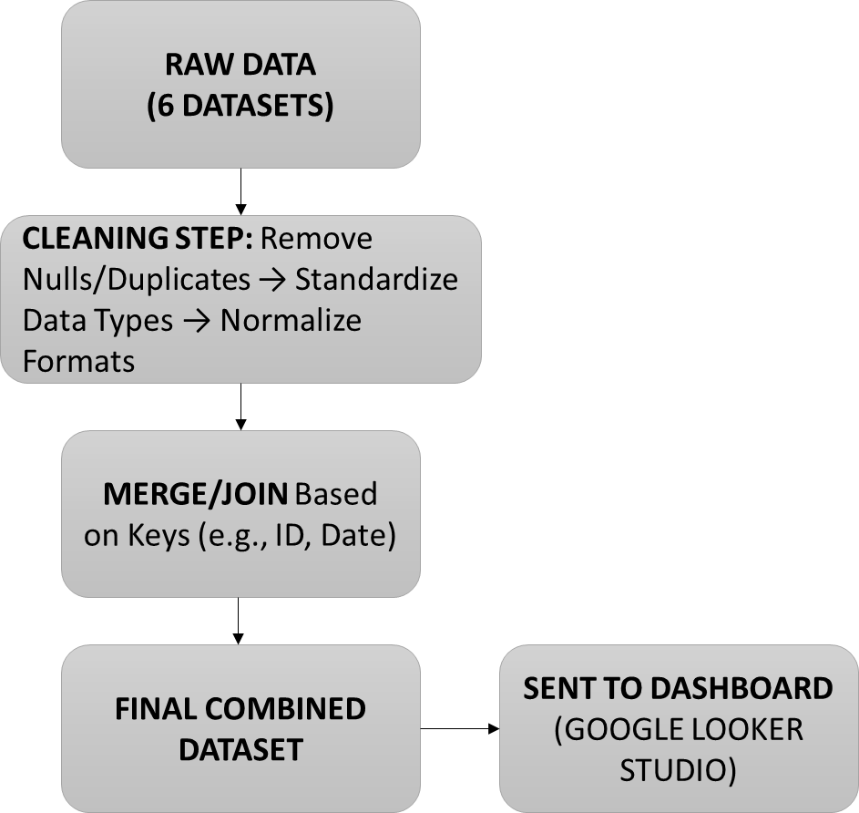
Data Cleaning & Processing Workflow

Slide 16
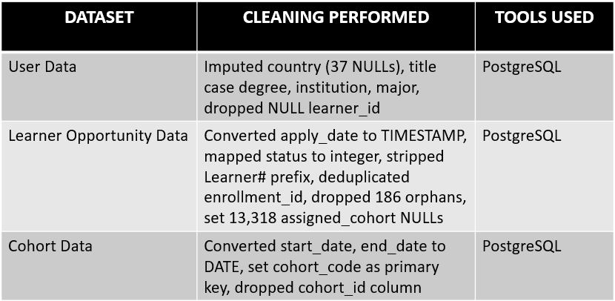
Data Cleaning and Processing for Master Table:

Slide 17
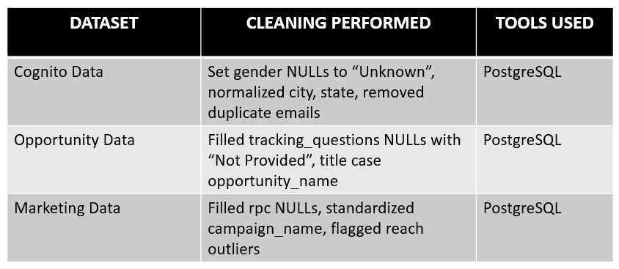
Data Cleaning and Processing for Master Table:

Slide 18
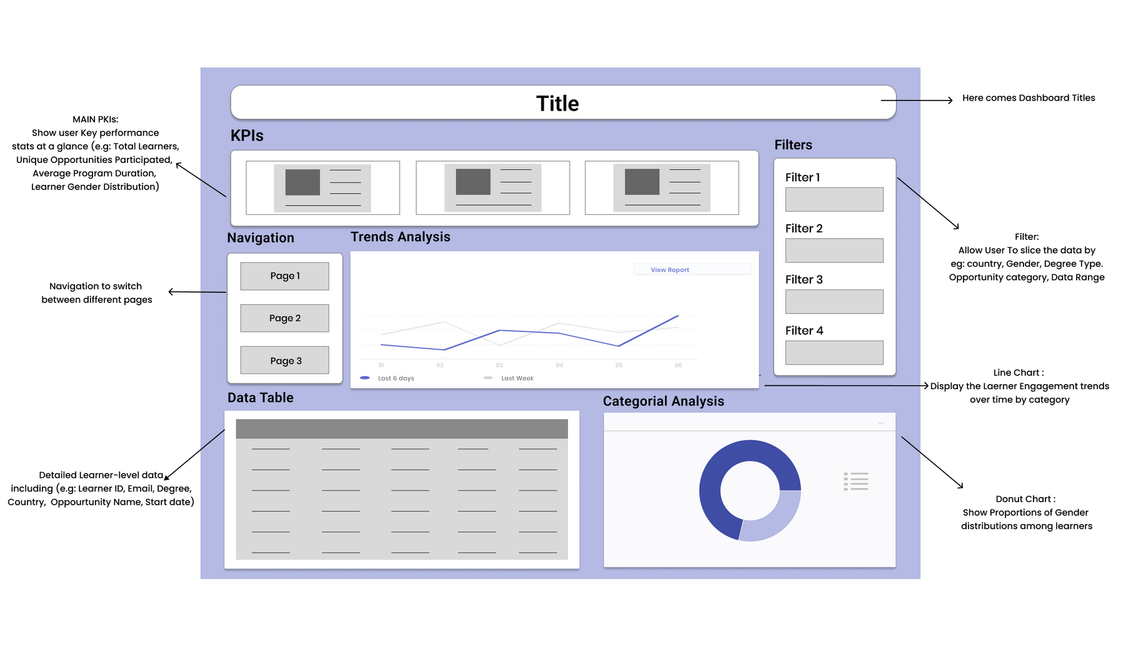
WIREFRAME

Slide 19
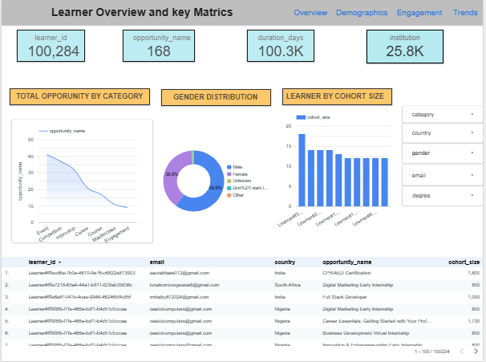
Dashboard: Overview of Learner Metrics

Slide 20
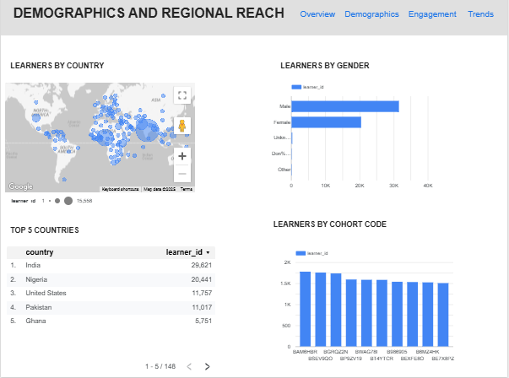
Learner Reach by Country, Gender, and Cohort

Slide 21
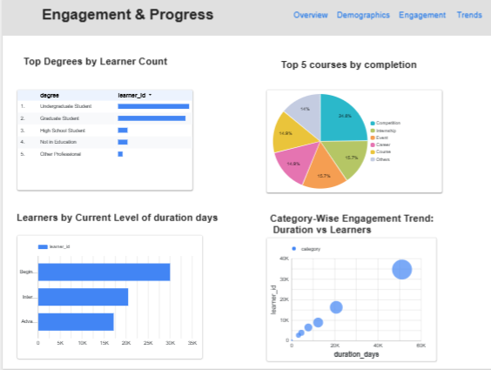
Learner Involvement by Education Level and Course Activity

Slide 22
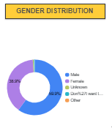
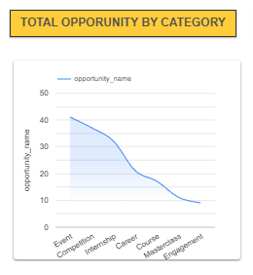
Data Visuals And Key Insights(1/4):
BALANCED GENDER DISTRIBUTION
100K+ LEARNERS, 168 UNIQUE OPPORTUNITIES

Slide 23
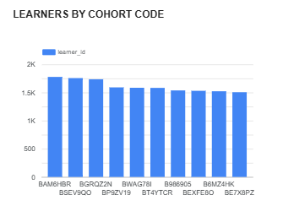
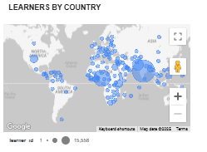
Data Visuals And Key Insights(2/4):
CERTAIN COHORT CODES HAVE CONSISTENTLY HIGH PARTICIPATION
LEARNER ENGAGEMENT ACROSS COUNTRIES

Slide 24
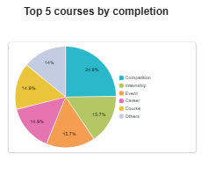
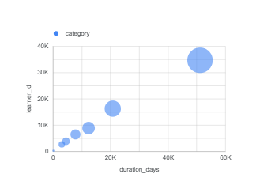
Data Visuals And Key Insights(3/4):
Positive Correlation Between Duration and Participation
TOP 5 COURSES DOMINATE COMPLETION RATES
LONGER OPPORTUNITIES ATTRACT MORE LEARNERS
(BUBBLE CHART INSIGHT)

Slide 25
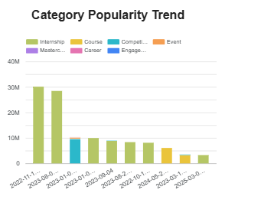
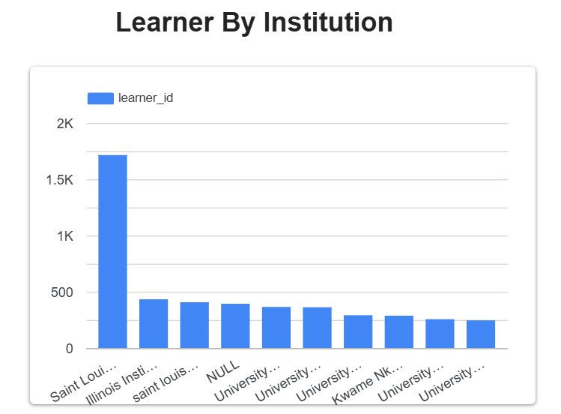
Data Visuals And Key Insights(4/4):
YEAR-WISE ENGAGEMENT BY CATEGORY
YEAR-WISE ENGAGEMENT BY CATEGORY

Slide 26
CONCLUSION
Our collaborative efforts in data cleaning, processing, and visualization were essential in uncovering meaningful insights into learner participation, regional demographics, and engagement trends. The analysis showed strong involvement from countries like India and Nigeria, a mostly student audience, and a clear preference for longer-duration opportunities. Balanced gender distribution and cohort trends offered valuable guidance for targeted outreach and course planning, while our structured approach improved reporting accuracy and decision-making.

Slide 27
OUR DASHBOARD LINK
https://lookerstudio.google.com/u/0/reporting/e5b1fd8d-3b78-4b7e-aa53-fa294c88be91/page/xnoIF

Slide 28


RECOMMENDATIONS
Expand Targeted Outreach in High-Engagement Regions:
Capitalize on high learner participation from countries like India, Nigeria, and Pakistan by running targeted marketing campaigns and building partnerships with regional institutions.
Develop Advanced and Specialized Learning Programs
Since most learners are undergraduate or graduate students, offer higher-level certifications and specialized courses to meet their learning needs and maintain engagement.

Slide 29


RECOMMENDATIONS
Prioritize Long-Duration Opportunities
Learners show greater interest in longer-duration courses, indicating a preference for in-depth learning. Consider designing more comprehensive programs within top-performing categories.
Enhance Data Quality and Dashboard Interactivity
Implement automated data cleaning processes to ensure consistent, accurate reporting. Expand dashboards with interactive filters to monitor learner progress, regional trends, and cohort performance.

Slide 30
THANK YOU!

